Slide 1


React JS
(passing argument to event handler )
Lecture-21

Slide 2
Today’s Agenda
Passing Arguments To Event Handlers
Different Ways Of Passing Arguments
Examples
Exercises

Slide 3
Argument Passing To
Event Handlers
When we work with a React component we can attach an event to onClick (or other events) as shown below:
<button onClick={this.showBill}>Show Bill</button>

Slide 4
Argument Passing To
Event Handlers
But what if we have to pass an argument?
For example , suppose we have a list of products in a shopping cart, and we want to remove a particular product by clicking the “Delete Button” next to it.
So we can we do this ?
<button onClick={this.removeFromCart(this.id)}>Delete</button>

Slide 5
Argument Passing To
Event Handlers
The answer is a BIG NO
This is because the expression inside onClick is going to be executed as soon as cart is rendered.
This is going to delete all the products in the cart, as soon as the Shopping Car is rendered.

Slide 6
Different Ways Of
Passing Arguments
React provides us three ways to pass arguments to event handler methods and they are:
Routing the call through a function
Passing arrow function to event props like onClick
Passing arguments to bind()

Slide 7
What About ‘e’ ?
In all cases, the e argument representing the react event will be passed as last argument .
With an arrow function, we have to pass it explicitly, but with bind(), any further arguments are automatically forwarded.

Slide 8
Routing Call Through
A Function
In this approach we create two methods for event handling , as follows:
The first method will be non parametrized and will be set in onClick
The second method will be parametrized and will be called by the first method with appropriate arguments

Slide 9
Exercise
Create an app with the following files:
Student.js: This file should contain following members:
2 props called roll and name
handleClick() :Which accepts roll and name as argument and displays them in console
handleArgClick() :Which calls handleClick() with required arguments
render() : For rendering a Button which when clicked calls the handleArgClick() method
App.js: This file should render the Student component
index.js: To render the App component

Slide 10
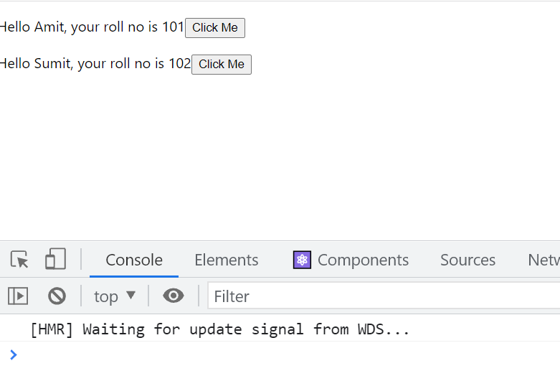
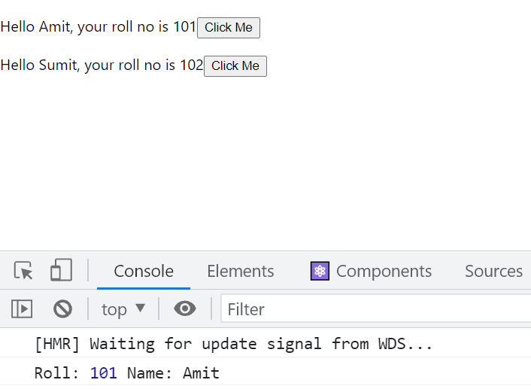
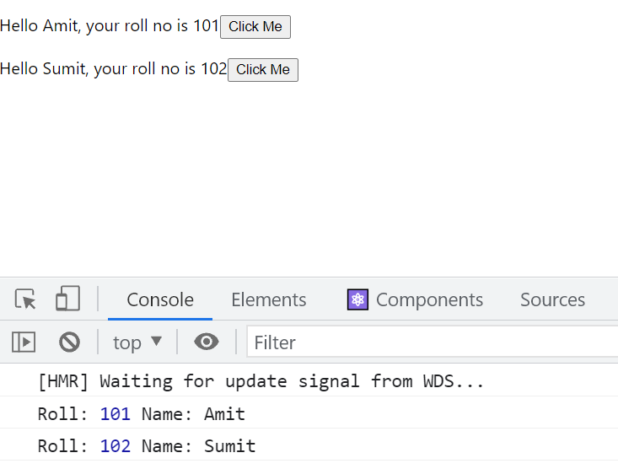
Desired Output
Initial Output
After clicking first button
After clicking second button

Slide 11
Solution
Student.js
import React, { Component } from "react";
class Student extends Component {
handleClick(roll, name, e) {
console.log("Roll:", roll, "Name:", name);
}
handleClickArg = (e) => {
this.handleClick(this.props.roll, this.props.name,e);
};
render() {
return (
<p>
Hello {this.props.name}, your roll no is {this.props.roll}
<button onClick={this.handleClickArg}>Click Me</button>
</p>
);
}
}
export default Student;

Slide 12
Solution
App.js
import React, { Component } from "react";
import Student from "./Student";
class App extends Component {
render() {
return (
<div>
<Student roll={101} name={"Amit"} />
<Student roll={102} name={"Sumit"} />
</div>
);
}
}
export default App;

Slide 13
Passing Anonymous Function
To onClick
Instead of routing the call to handleClick() through an extra method , we can simply pass an arrow function to the onClick property while rendering the Button
This means that we can remove the intermediate function handleClickArg() and put its code directly in onClick as arrow function

Slide 14
Solution
Student.js
import React, { Component } from "react";
class Student extends Component {
handleClick(roll, name, e) {
console.log("Roll:", roll, "Name:", name);
}
render() {
return (
<p>
Hello {this.props.name}, your roll no is {this.props.roll}
<button
onClick={(e) => this.handleClick(this.props.roll, this.props.name, e)}
>
Click Me
</button>
</p>
);
}
}
export default Student;

Slide 15
Passing Argument
Through bind()
If we recall the syntax of bind() , then we can see that it allows us to pass extra arguments after “this” .
fn.bind(thisArg,<optional arguments>)
All these arguments are sent as parameters to the event handler function when the event is fired

Slide 16
Solution
Student.js
import React, { Component } from "react";
class Student extends Component {
handleClick(roll, name, e) {
console.log("Roll:", roll, "Name:", name);
}
render() {
return (
<p>
Hello {this.props.name}, your roll no is {this.props.roll}
<button
onClick={this.handleClick.bind(
this,
this.props.roll,
this.props.name
)}
>
Click Me
</button>
</p>
);
}
}
export default Student;

Slide 17
Exercise
Create an app with the following files:
MyClicker.js: This file should contain following members:
a state called counter
handleClick() :Which accepts step and increments the counter accordingly
render() : For rendering 3 Buttons which when clicked get the counter incremented by 1 , 2 or 3 respectively
App.js: This file should render the MyClicker component
index.js: To render the App component

Slide 18


Desired Output
Initial Output
After clicking first button

Slide 19


Desired Output
After clicking sec button
After clicking third button

Slide 20
Exercise
Create a ProductList app which should do the following:
Display a list of product names as well as a delete button with each product
These product names will be passed from App.js
On clicking a button the corresponding product must be deleted

Slide 21
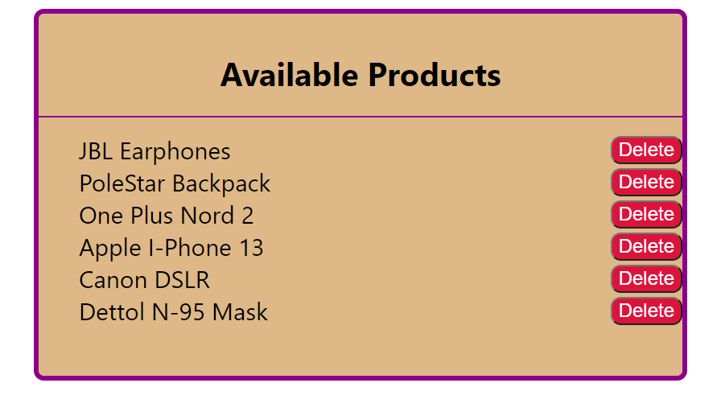
Desired Output
Initial Output

Slide 22
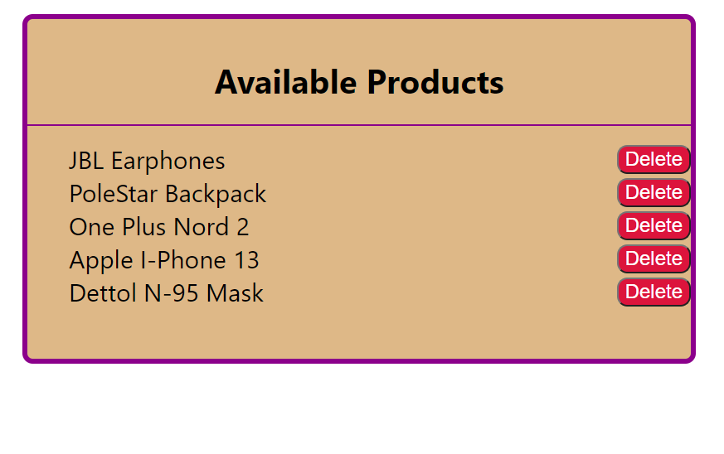
Desired Output
After clicking delete button of Cannon DSLR

Slide 23
The Concept Of “key”
In the previous exercise or any other React app where we have rendered a list using map() method , we can notice that React always gives us a warning:
Warning: Each child in a list should have a unique "key" prop
So now lets discuss what is this warning all about and how we can remove it.

Slide 24
So , What Is A Key ?
Simply put, they are props that are passed in child elements of a list in order to:
Identify which elements are added.
Identify which elements are updated.
Identify which elements are removed.
Hence, keys serve as identification for an element just like how Aadhar Card is used to identify people.

Slide 25
How Do We Create A Key?
We can easily add keys to list elements like so:
<li key="1">first</li>
<li key="2">second</li>
<li key="3">third</li>
Keys should be a unique identifier so that each element can be identified properly.
Therefore, it is recommended to use some uniquely generated id as the key.

Slide 26
Updating Our Product Component
In our previous exercise , we can pass the prop key while creating <Product> component, as shown below
<Product key={item} value={item} remove={this.deleteItem} />
Since key has to be unique so we are using item name itself as the key

Slide 27
Few Important Points !
Make sure that every item in the list has a unique key.
It is prefered to not use indexes as a key unless we know for sure that the list is a static list (no additions/re-ordering/removal to the list).
Never use any unstable keys like Math.random() to generate a key.
React will run into performance degradation and unexpected behaviour if unstable keys are used.

Slide 28
Few Important Points !
Keys are not the same as props, only the method of assigning a “key” to a component is the same as that of props.
Keys are internal to React and can not be accessed from inside of the component like props

